Slide 1

Reading Files

Slide 2
Table of Contents
open() Function
mode Parameter
Reading the Files with '.read()' Method
Reading the Files with '.readline()' Method
Reading the Files with '.readlines()' Method
Reading the Files with Loops
The Matter of Closing the Files

Slide 3
open() Function
1

Slide 4



How was your pre-class content. Did you understand the “Reading Files with Python”?
Notes:
Hard or Easy
Use this template to do a quick temperature check and self-reflection about the homework. You can learn which students might have struggled with the assignment and therefore might need more attention today.
🍐 This is a Pear Deck Draggable™ Slide.
🍐 To edit the type of question, go back to the "Ask Students a Question" in the Pear Deck sidebar.

Slide 5
open() Function (review)
To start working with files, we need to open it first by using a built-in function open(). According to the official related Python documents, it has the following parameters :
open (file, mode='r', buffering=-1, encoding=None, errors=None, newline=None, closefd=True, opener=None)

Slide 6
open() Function (review)
We will mostly examine and work with some of the following parameters of the open() function :
open (file, mode='r', buffering=-1, encoding=None, errors=None, newline=None, closefd=True, opener=None)
file
encoding
mode

Slide 7
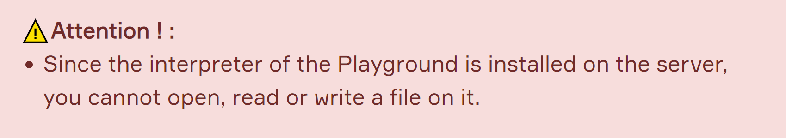
open() Function (review)
file
file is the only required parameter of the open() function. This parameter is a path-like object which is a str or bytes that represents a path in the file directory.
This parameter takes the name of the file that you want to open which is stored in the directory where the Python installed. In other words, the file should be stored in the current working directory.

Slide 8
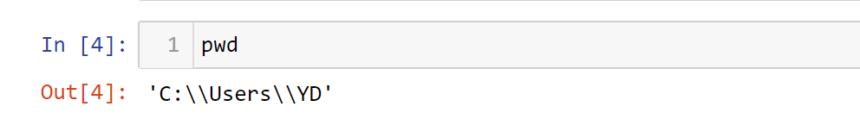
open() Function (review)
You can see the current path of your Jupyter using pwd command.

Slide 9
open() Function (review)
file
In the following example, you see that we open a .txt file object. We passed the required parameter (file) into the open() function.

Slide 10
open() Function (review)
file
It opens the file and returns a corresponding file-like object. If the file cannot be opened, an OSError is raised. Pay attention to the type of my_file. We have created a file-like object. So we can apply different kinds of methods to my_file.

Slide 11
open() Function (review)
encoding
The encoding parameter indicates the encoding that needs to be used to decode or encode a file. The default value depends on the platform you use and its language.
UTF-8 is one of the most preferred used encodings, and Python generally defaults to using it. UTF stands for “Unicode Transformation Format”, and the ‘8’ means that 8-bit values are used in the encoding.
We can open a file in the same way by using the following syntax :

Slide 12


I have learned enough about the encoding parameter so far.
True
False
Notes:
True or False
Use this template to do a quick check of students’ perceptions during your lesson.
🍐 This is a Pear Deck Multiple Choice Slide. Your current options are: A: True, B: False,
🍐 To edit the type of question or choices, go back to the "Ask Students a Question" in the Pear Deck sidebar.

Slide 13
mode Parameter
mode
2

Slide 14
mode Parameter (review)
mode parameter has several options that regulate how or for what purpose we open the file. These options are as follows :
Character | What it's used for?
'r' | Open for reading (default). If the file doesn't exist, FileNotFoundError will raise.
'a' | Open for writing. It will append to the end of the file if it already exists. If there is no file, it will create it.
'w' | Open for writing. It will be overwritten if the file already exists. If there is no file, it will create it.
'x' | Open for exclusive creation, it will fail if the file already exists.
'b' | Open in binary mode.
't' | Open as a text file (default).
'+' | Open for updating (reading and writing).

Slide 15
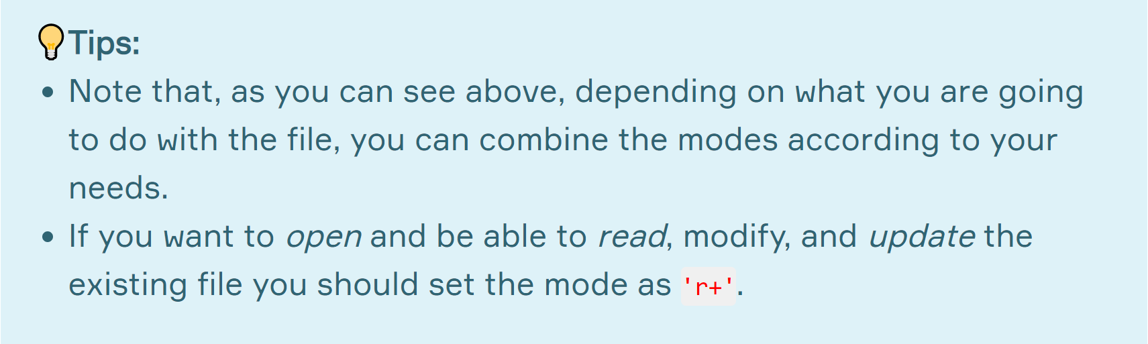
mode Parameter (review)
By default, open() function executes opening the file for reading ('r') as a text ('t'). In other words, it defaults to 'r' or 'rt' which means open for reading in text mode.

Slide 16

mode Parameter (review)
Another important point we should cover about mode is that you can choose the format in which you want to open the file as text ('t') or binary ('b').
most common use
'b'
't'
Returns contents as bytes objects without any decoding.
The contents of the file are returned as str.
It’s default for mode parameter.

Slide 17
Reading the Files
with .read() Method
3

Slide 18
Reading Methods
You can use the following methods for reading a file :
.read(size)
.readline(size)
.readlines()
using loops

Slide 19
Reading Methods
.read(size)

Slide 20
Reading Methods
First of all, we need to create a text file and save it in the folder where Anaconda3 / Python is installed. Suppose we have a file named "fishes.txt" with the following content.
fishes.txt
Orca is a kind of Dolphin.
Blue Whale is the largest animal known on earth.
Sharks are the sister group to the Rays (batoids).
The Tuna Fish can weigh up to 260 kg.
Squid and Octopus are in the same class.

Slide 21

Reading Methods
Keep in your mind!
You can pass full path of the file into open() function. So that, when the file path is entered, the location where the file is saved does not matter.
file = open("C:/users/desktop/fishes.txt", "r")

Slide 22
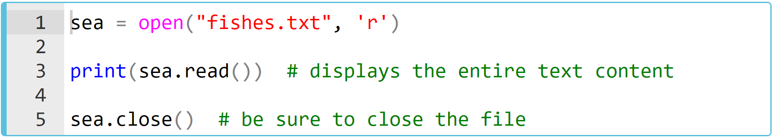
.read() Method (review)
This method reads the size bytes (characters) of the file. If this parameter is not specified, the entire file is read at once.
What is the output? Try to figure out in your mind...
Notes:
🍐 This is a Pear Deck Text Slide
🍐 To edit the type of question, go back to the "Ask Students a Question" in the Pear Deck sidebar.

Slide 23
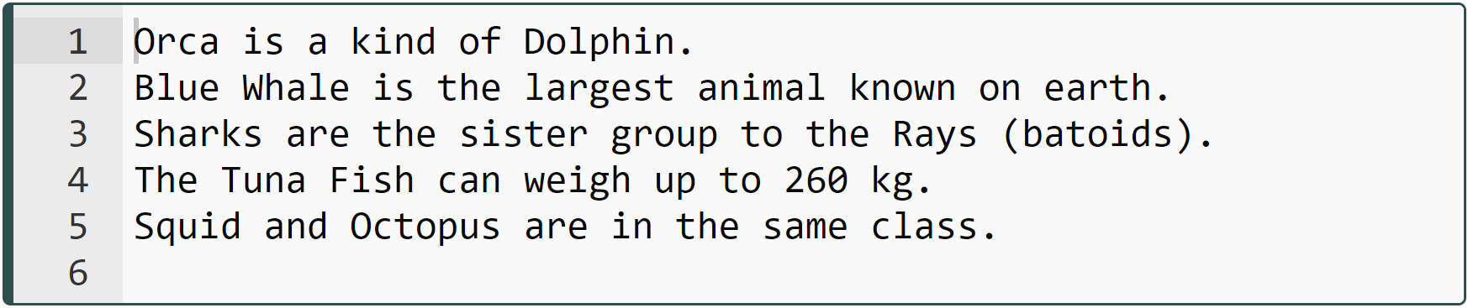
.read() Method (review)
This method reads the size bytes (characters) of the file. If this parameter is not specified, the entire file is read at once.

Slide 24
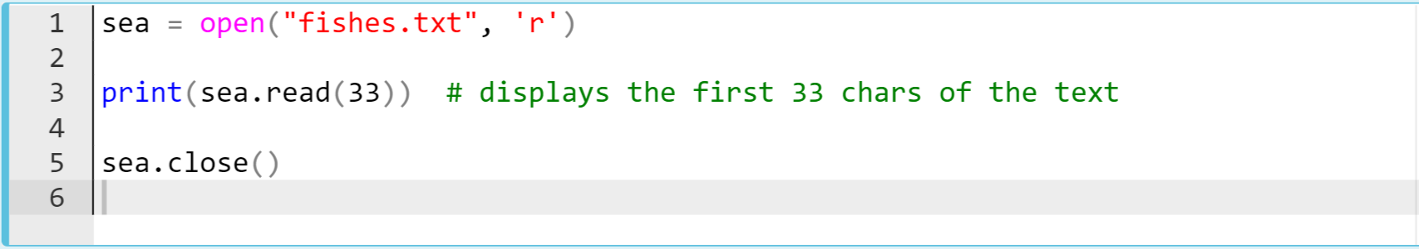
.read() Method (review)
Now let's do some readings using the size parameter. It specifies the sequence number of the characters starting at number 1.
What is the output? Try to figure out in your mind...

Slide 25
.read() Method (review)
The output :

Slide 26
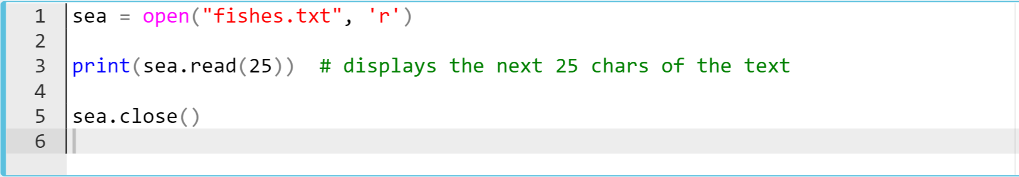
.read() Method (review)
Now let's continue to read using the size parameter.
What is the output? Try to figure out in your mind...

Slide 27
.read() Method (review)
The output :

Slide 28
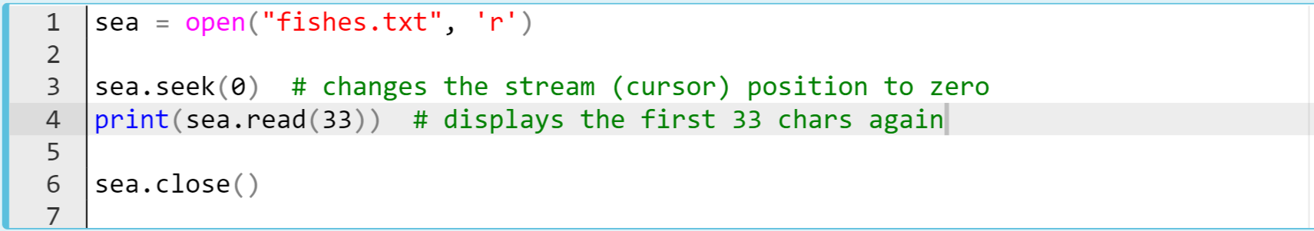
.read() Method (review)
Now let's continue to read using the size parameter.
What is the output? Try to figure out in your mind...

Slide 29
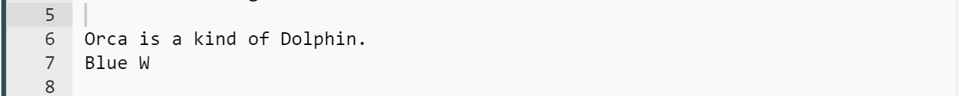
.read() Method (review)
The output :

Slide 30
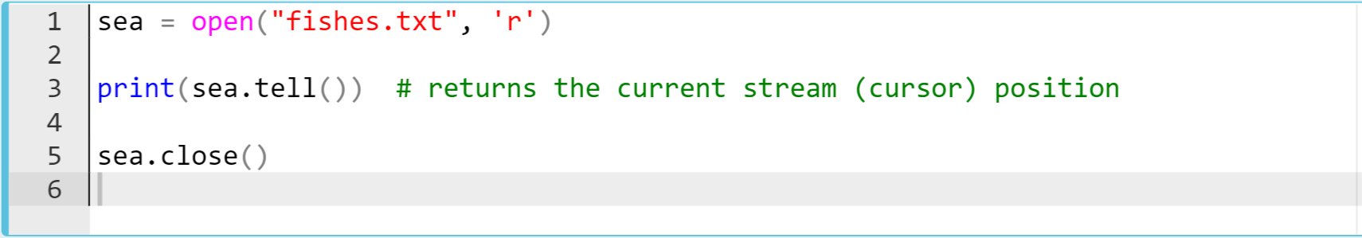
.read() Method (review)
Now let's continue to read using the size parameter.
What is the output? Try to figure out in your mind...

Slide 31
.read() Method (review)
The output :

Slide 32
.read() Method
Task :
Create a txt file named rumi.txt in your current directory consisting of the following quotes of Rumi.
rumi.txt
I want to sing
Like the birds sing,
Not worrying about
Who hears or
What they think.

Slide 33
.read() Method
Task (continued):
Create a txt file named rumi.txt in your current directory consisting of the following quotes of Rumi.
Read and display the entire contents of this file at once.
Display the first two lines using read() method.

Slide 34
.read() Method (review)
Task (continued):
Display the next 13 chars of the content,
Display the current location of the cursor,
Bring the cursor onto beginning of the second line and display the second line again.
Close the file.

Slide 35
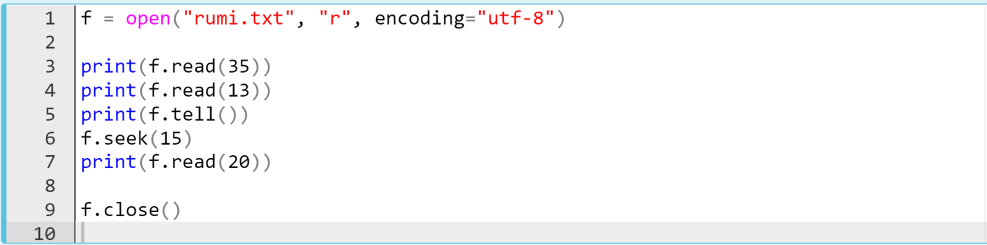
.read() Method (review)
The entire code block can be as follows (suppose you’ve created the rumi.txt manually into your current directory:

Slide 36
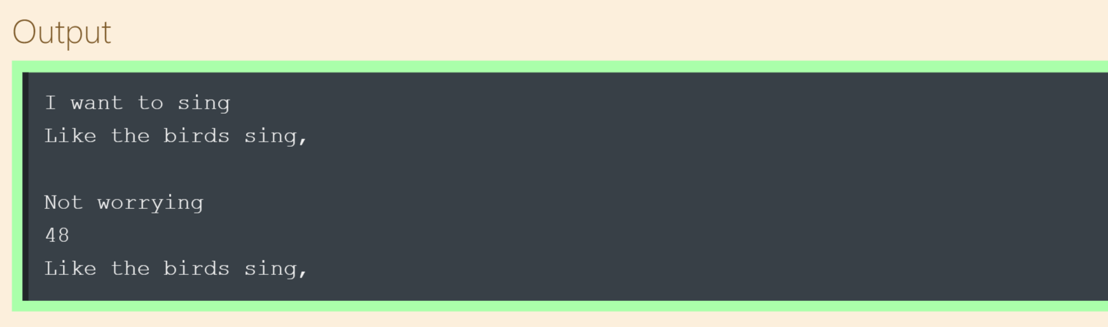
.read() Method (review)
The output :
First 35 chars (first two lines)
The next 13 chars
The current location of the cursor

Slide 37
Reading the Files
with .readline() Method
4

Slide 38
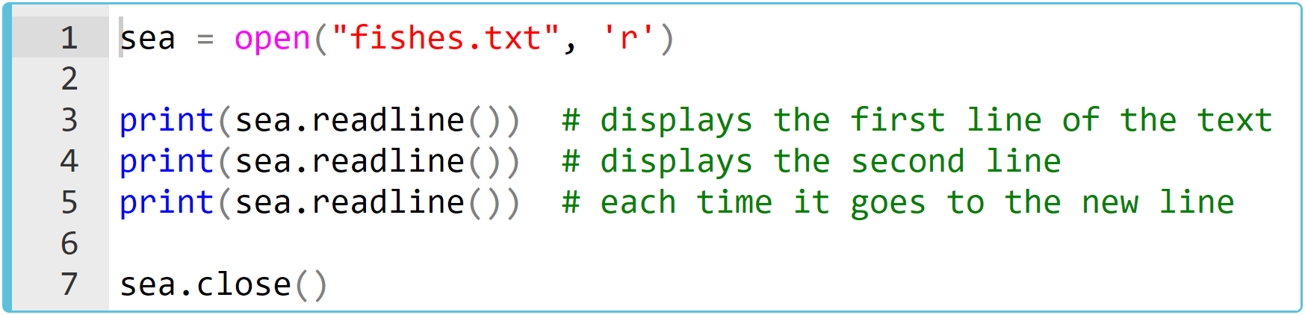
.readline() Method (review)
This method reads only size bytes from a single line of the text. Now let's start to examine this method through an example :
What is the output? Try to figure out in your mind...

Slide 39
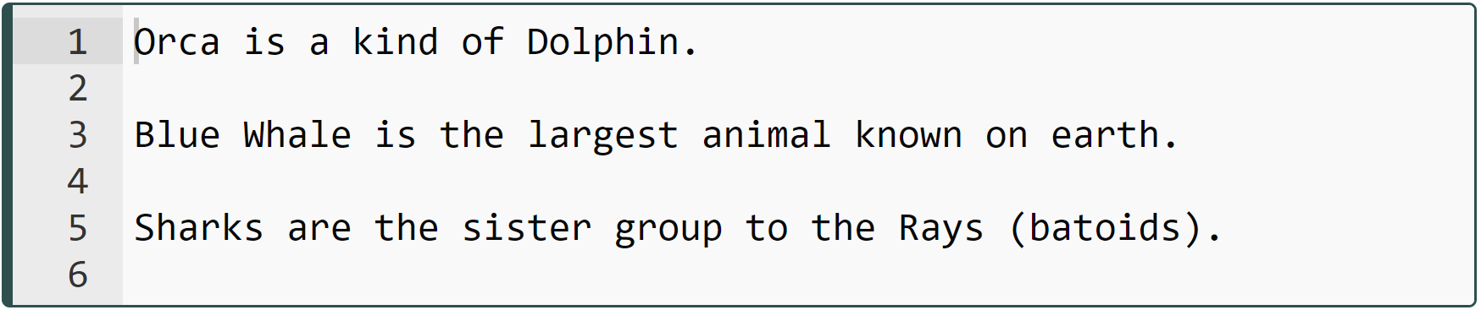
.readline() Method (review)
The output :

Slide 40
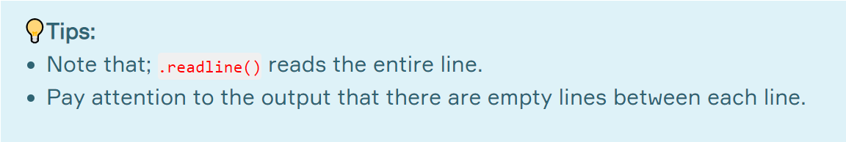
.readline() Method (review)
Now, let's take a look at an example using the size parameter. The first line of the text contains 26 bytes (characters) except the newline char (\n). But, note that the newline character (\n) is considered as a part of each line.

Slide 41
.readline() Method (review)
So that, first line of text consists of 27 characters. Let's choose 13 as the size parameter and see what happens :
fishes.txt
Orca is a kind of Dolphin.
Blue Whale is the largest animal known on earth.
Sharks are the sister group to the Rays (batoids).
The Tuna Fish can weigh up to 260 kg.
Squid and Octopus are in the same class.

Slide 42
.readline() Method (review)
fishes.txt
Orca is a kind of Dolphin.\n
|||||||||||||||||||||||||||=27
Orca is a kind of Dolphin.
Blue Whale is the largest animal known on earth.
Sharks are the sister group to the Rays (batoids).
The Tuna Fish can weigh up to 260 kg.
Squid and Octopus are in the same class.

Slide 43
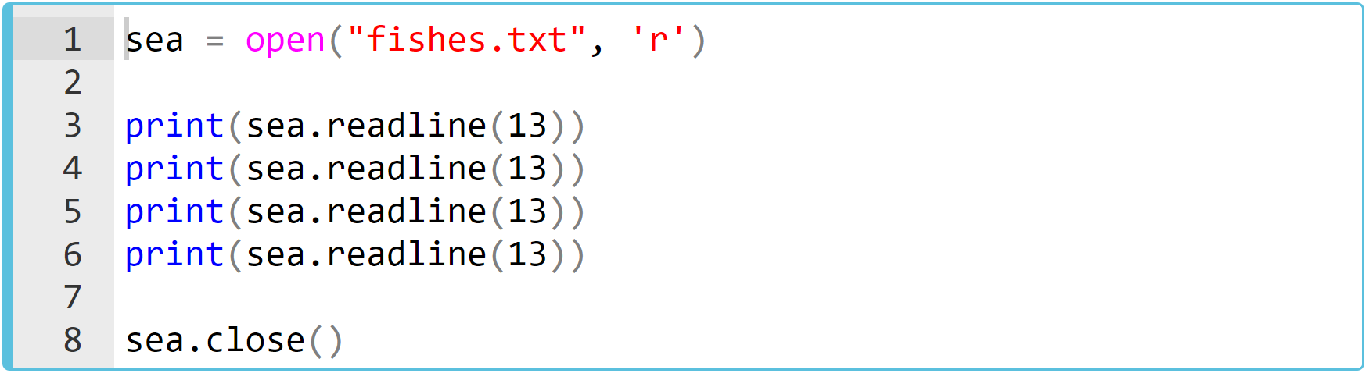
.readline() Method (review)
What is the output? Try to figure out in your mind...
Notes:
🍐 This is a Pear Deck Text Slide
🍐 To edit the type of question, go back to the "Ask Students a Question" in the Pear Deck sidebar.
As you can see, the .readline(13) reads 13 chars through the line and it continues to read 13 chars each until the line ends, and only then passes to the next line. In this example, considering the first line consists of 27 characters, the print(sea.readline(13)) syntax can read the entire line in a total of three repetitions. The output has two empty lines. One of them is caused by the last character (\n) of the first line and the other is because of the default empty line that the .readline() method puts between each line.

Slide 44
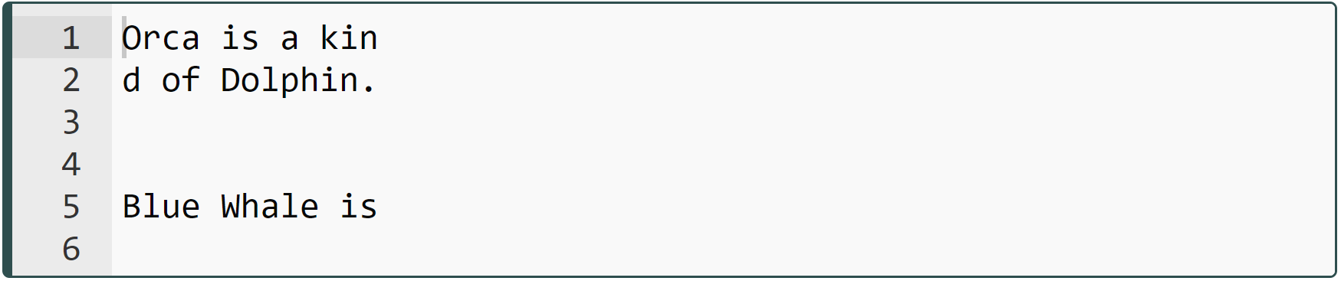
.readline() Method (review)
\n is the last char of the first line
when a line ends, whatever the size parameter is, it goes ahead to the next line
default empty line
Notes:
As you can see, the .readline(13) reads 13 chars through the line and it continues to read 13 chars each until the line ends, and only then passes to the next line. In this example, considering the first line consists of 27 characters, the print(sea.readline(13)) syntax can read the entire line in a total of three repetitions. The output has two empty lines. One of them is caused by the last character (\n) of the first line and the other is because of the default empty line that the .readline() method puts between each line.

Slide 45
.readline() Method
Task :
Consider the rumi.txt file you created before.
rumi.txt
I want to sing
Like the birds sing,
Not worrying about
Who hears or
What they think.

Slide 46
.readline() Method
Task (continued) :
Read and display the first line of this file,
Read and display the second line of this file,
Read and display the third line of this file using size parameter in the method,
Close the file.

Slide 47
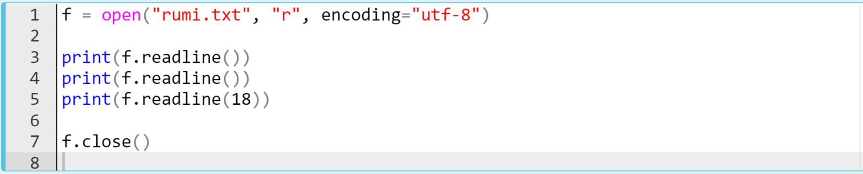
.readline() Method
The entire code block can be as follows (suppose you’ve created the rumi.txt manually into your current directory:

Slide 48
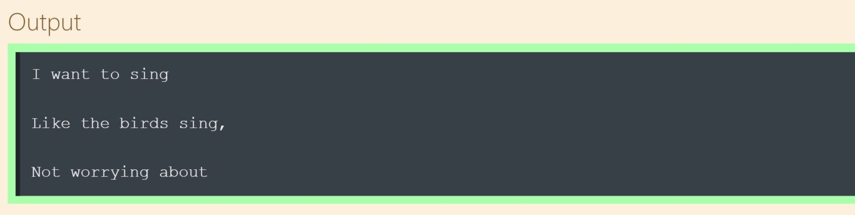
.readline() Method
The output :
reading of 18 chars displays the third line

Slide 49
Reading the Files
with .readlines() Method
5

Slide 50
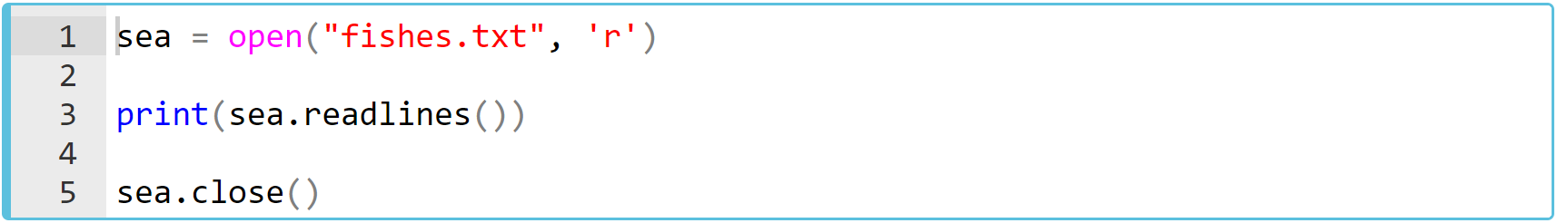
.readlines() Method (review)
And the third method in reading the files in Python is .readlines(). It reads the entire file line by line in the list form.
Using our same text file, let's look at the following example on how the output looks like :
What is the output? Try to figure out in your mind...

Slide 51
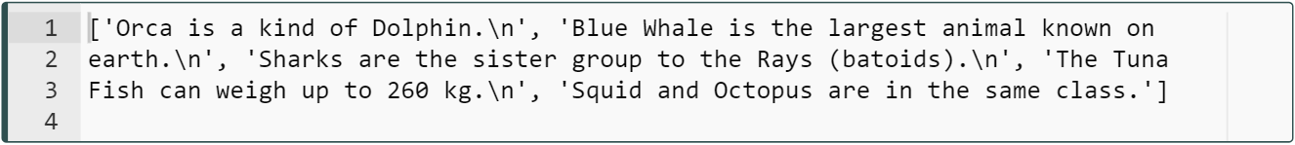
.readlines() Method (review)
The output :
Notes:
As you can see in the output, all lines are displayed as separate elements of a list. You can easily see the fact that the newline character (\n) is a part of the line we've mentioned before.

Slide 52
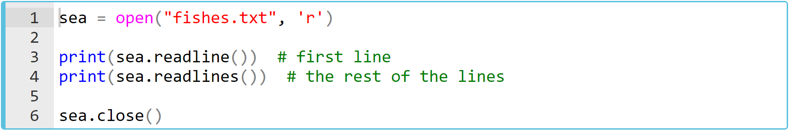
.readlines() Method (review)
Let's take a look at the following example where .readline() and .readlines() are used together.
What is the output? Try to figure out in your mind...
Notes:
🍐 This is a Pear Deck Text Slide
🍐 To edit the type of question, go back to the "Ask Students a Question" in the Pear Deck sidebar.

Slide 53
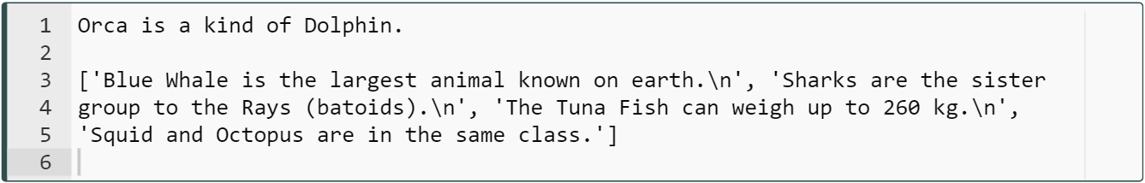
.readlines() Method (review)
The output :
Notes:
The position of the stream (cursor) makes sense when using these methods. If we make the file read using one of these methods, each time we use the print(method) syntax it continues reading from where the cursor is.

Slide 54
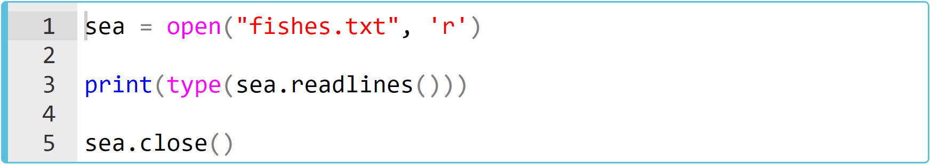
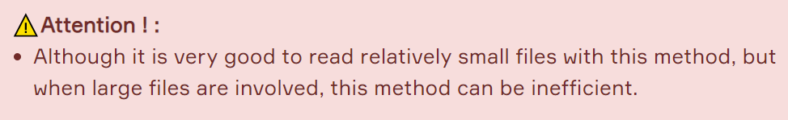
.readlines() Method (review)
You may have noticed that the type of the sea.readlines() object is the list. Let's see it :

Slide 55
.readlines() Method
Task :
Consider the rumi.txt file you created before.
rumi.txt
I want to sing
Like the birds sing,
Not worrying about
Who hears or
What they think.

Slide 56
.readlines() Method
Task (continued) :
Read and display the entire file in a list form,
Close the file.

Slide 57
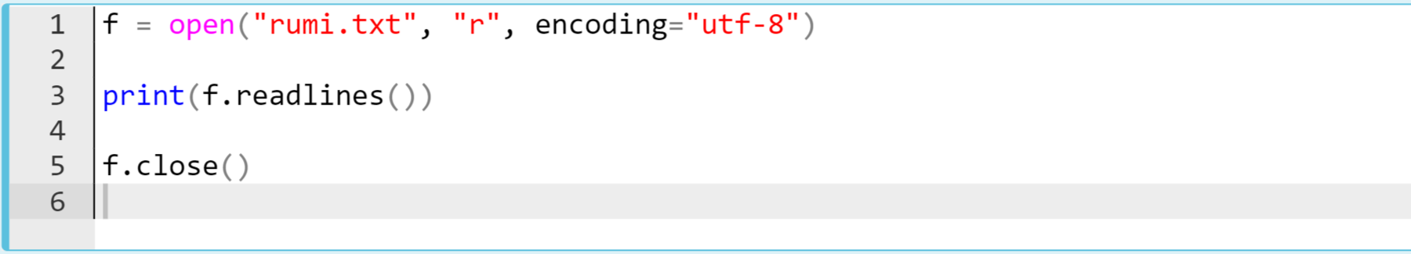
.readlines() Method
The entire code block can be as follows (suppose you’ve created the rumi.txt manually into your current directory:

Slide 58
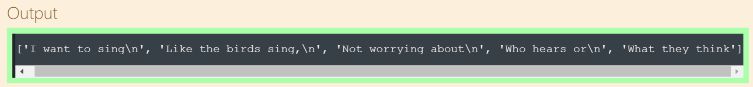
.readlines() Method
The output :

Slide 59
Reading the Files
with loops
6

Slide 60
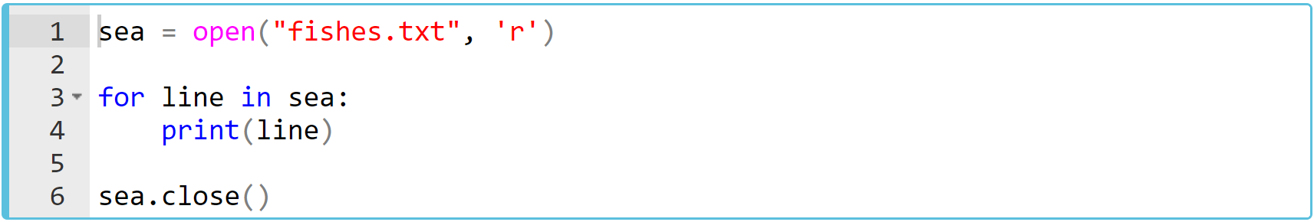
Reading the Files with Loops(review)
The most efficient way to read the contents of a file is using the for loop. Let's take a look at an example of how we do this.
What is the output? Try to figure out in your mind...

Slide 61
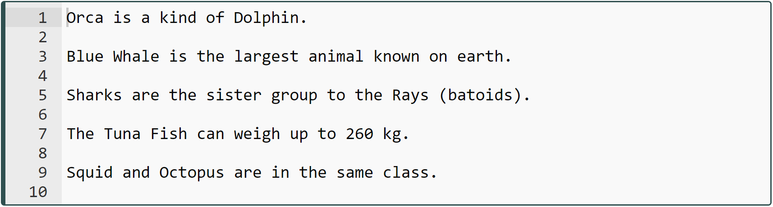
Reading the Files with Loops(review)
The output :
Notes:
In this way, especially large text files can be read easily and practically. This method gives us the opportunity to read the line we want, as well as freeing us from syntax repetition.

Slide 62
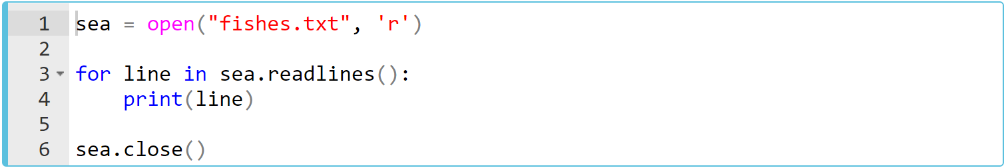
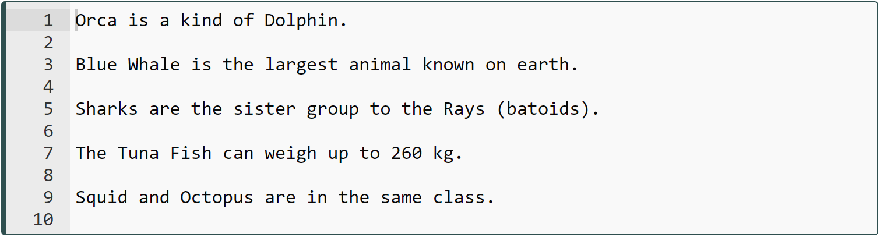
Reading the Files with Loops(review)
Since the type of sea.readlines() object is a list, we can use it as an iterator and read the whole file in the same way.

Slide 63
Reading the Files with Loops
Task :
Consider the rumi.txt file you created before.
rumi.txt
I want to sing
Like the birds sing,
Not worrying about
Who hears or
What they think.

Slide 64
Reading the Files with Loops
Task (continued) :
Read and display the entire file with loops using file-like object as an iterator,
Read and display the entire file with loops using .readlines()-produced list as an iterator,
Close the file.

Slide 65
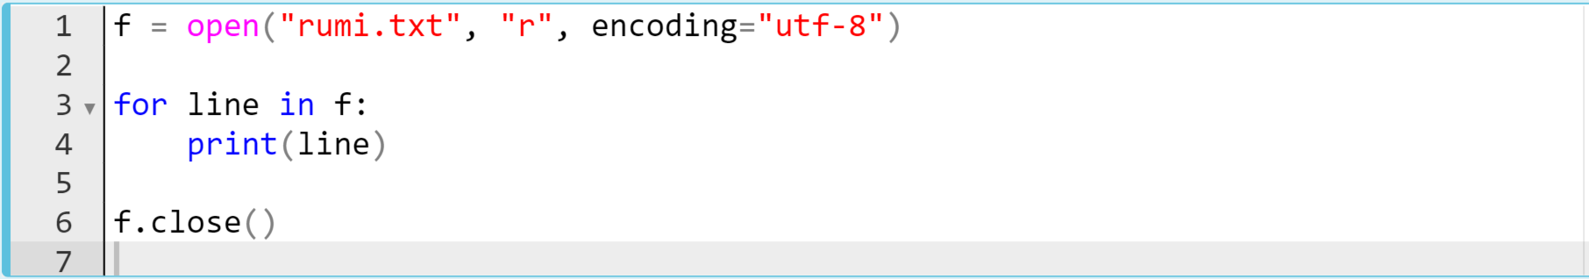
Reading the Files with Loops
The entire code block can be as follows (suppose you’ve created the rumi.txt manually into your current directory:
f is file-like object and it’s used as an iterator

Slide 66
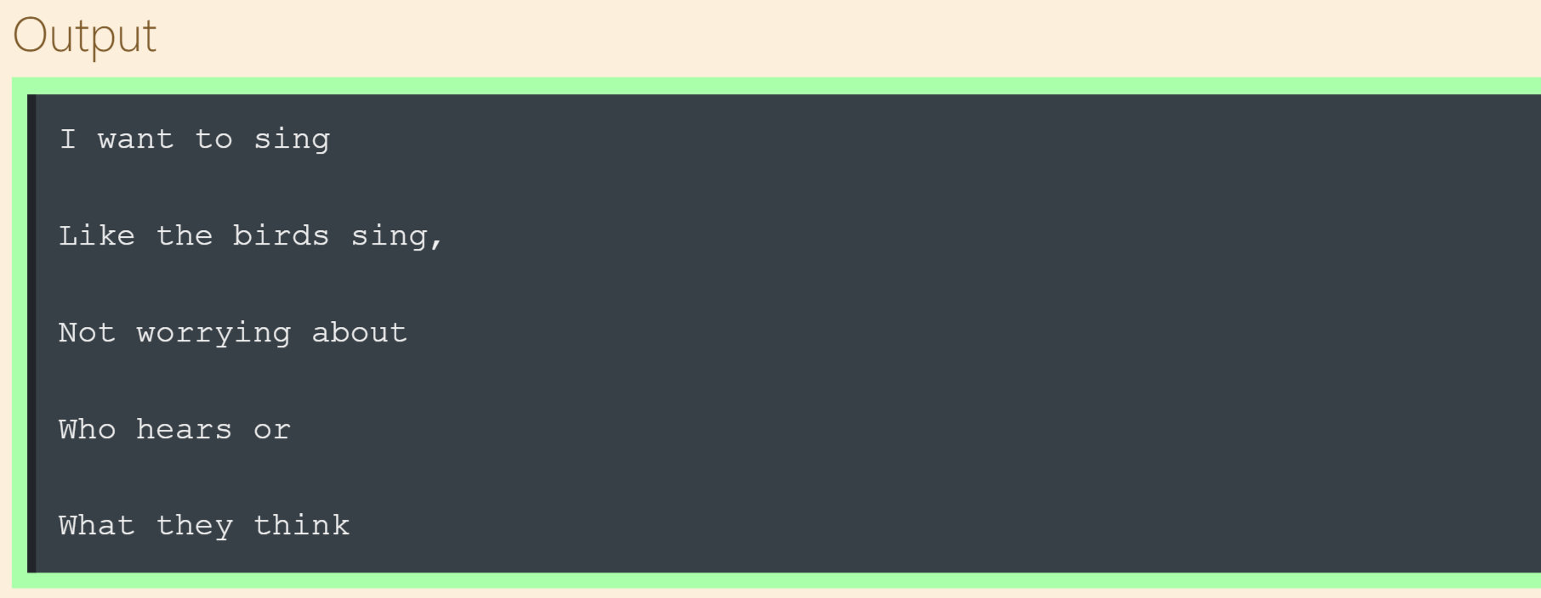
Reading the Files with Loops
The output :

Slide 67
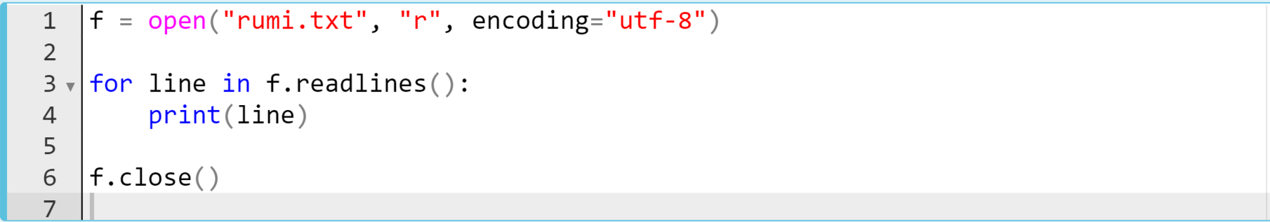
Reading the Files with Loops
The entire code block can be as follows (suppose you’ve created the rumi.txt manually into your current directory:
f.readlines() is a list type and it’s used as an iterator

Slide 68
Reading the Files with Loops
It gives the same output :

Slide 69
The Matter of Closing Files
7

Slide 70
The Matter of Closing the Files(review)
Workflow of working with files to be followed
Working with the file
Closing the file
opening the file

Slide 71
The Matter of Closing the Files(review)
Normally, when the program finishes running, that file is closed. But this does not happen at times and people forget to close these files that have been opened while working with them.
If we do not want to lose the data we are working with, we should keep in mind that the file should be closed as soon as our work is finished.

Slide 72
The Matter of Closing the Files(review)
As we mentioned, we can do the closing process with the close() method, but there is a slightly easier way to do this.
Using the with .... as ... block.
In fact, the actual use of the with ... as ... block is to make sure that all the necessary functions are called.
with open("my_file.txt", "r", encoding="utf-8") as f:
code block

Slide 73

The Matter of Closing the Files(review)
Take a look at the way we use it :
Notes:
As you can see, in this case, we don't need to use the close() method to close the file. It does this on its own.

Slide 74

Using the with … as … block
You can complete this assignment by yourself or in a group session later.
Create another txt file,
Implement the same steps (reading methods) in the tasks shown in this presentation.
Notes:
Instructions Template
Use this template to display instructions for your activity. Everyone works at a different pace. Help students who finish early know appropriate ways to use their time. For example, maybe you want them to help their peers, discuss with a peer, move on to a more advanced activity, or do some quiet reading.

Slide 75
How well did you like this lesson?
Notes:
Temperature Check
Get a sense for how well your lesson resonated with your students, or how engaged they were.
🍐 This is a Pear Deck Draggable™ Slide.
🍐 To edit the type of question, go back to the "Ask Students a Question" in the Pear Deck sidebar.

Slide 76

THANKS!
Any questions?
You can find me at:
joseph@clarusway.com

